Slide 1
Text Sentiment Analysis
NAME: Praveen Raj C
NM-ID:au711721243069
KGiSL Institute Of Technology
3/21/2024 Annual Review

Slide 2
PROJECT TITLE
Text Sentiment Analysis
3/21/2024 Annual Review

Slide 3


AGENDA
Problem Statement.
Project Overview.
End Users.
Our Solution and Proposition.
Key Features.
Modelling Approach
Results and Evaluation
3/21/2024 Annual Review

Slide 4

PROBLEM STATEMENT
Existing methods for user emotion detection can be complex or require labeled data. This project aims to create a user-friendly sentiment analysis tool that utilizes text data to readily identify user emotions.
3/21/2024 Annual Review

Slide 5

PROJECT OVERVIEW
This project tackles the challenge of efficiently identifying user emotions within text data.We present a user-friendly sentiment analysis tool that leverages Natural Language Processing (NLP) techniques for in-depth text analysis.The core of the system is a deep learning model utilizing Long Short-Term Memory (LSTM) networks to capture the nuances of sequential data and long-term emotional context within the text. To prevent overfitting, the model incorporates dropout layers during training.
3/21/2024 Annual Review

Slide 6

WHO ARE THE END USERS?
The target users for your project could encompass a variety of fields depending on the functionalities you've built in. Here are some potential user groups:
Customer Service Representatives: They can leverage the tool to analyze customer reviews, emails, and chat transcripts to gauge customer sentiment and improve interaction strategies.
Market Researchers: They can use it to analyze social media posts, surveys, and focus group discussions to understand customer emotions towards products, brands, or campaigns.
Educators or Tutors: They could use it to analyze student feedback or essays to understand student emotional responses to learning materials or assignments.
HR Professionals: They can potentially use it to analyze candidate cover letters or interview transcripts to gain insights into a candidate's emotional fit for a role.
3/21/2024 Annual Review

Slide 7

YOUR SOLUTION AND ITS VALUE PROPOSITION
Value Proposition:
Effortless User Emotion Detection:Identify user emotions within text data with ease. No need for complex set-up or expertise in NLP.
Actionable Insights:Gain valuable insights into user sentiment, allowing you to tailor your approach and improve outcomes.
Powerful & Accurate:Leverages advanced deep learning techniques for superior accuracy in identifying user emotions.
Combats Overfitting:Dropout layers prevent the model from memorizing data, ensuring reliable results.
User-Friendly Interface:Designed for accessibility, empowering a wider range of users to leverage sentiment analysis.
3/21/2024 Annual Review

Slide 8

THE WOW IN YOUR SOLUTION
1. Focus on a Specific Niche:
Go beyond basic emotions: Can your tool not only identify happy/sad/angry, but also detect more nuanced emotions like sarcasm, frustration, or excitement?
2. Visualization and User Experience:
Interactive visualizations: Can users explore sentiment trends over time or across demographics in a visually engaging way
Real-time analysis: Does your tool offer real-time sentiment analysis, allowing users to gauge immediate audience response
3. Advanced Techniques:
Attention Mechanism: Did you incorporate an attention mechanism within your LSTM network to focus on the most relevant parts of the text for sentiment classification?
3/21/2024 Annual Review
‹#›

Slide 9
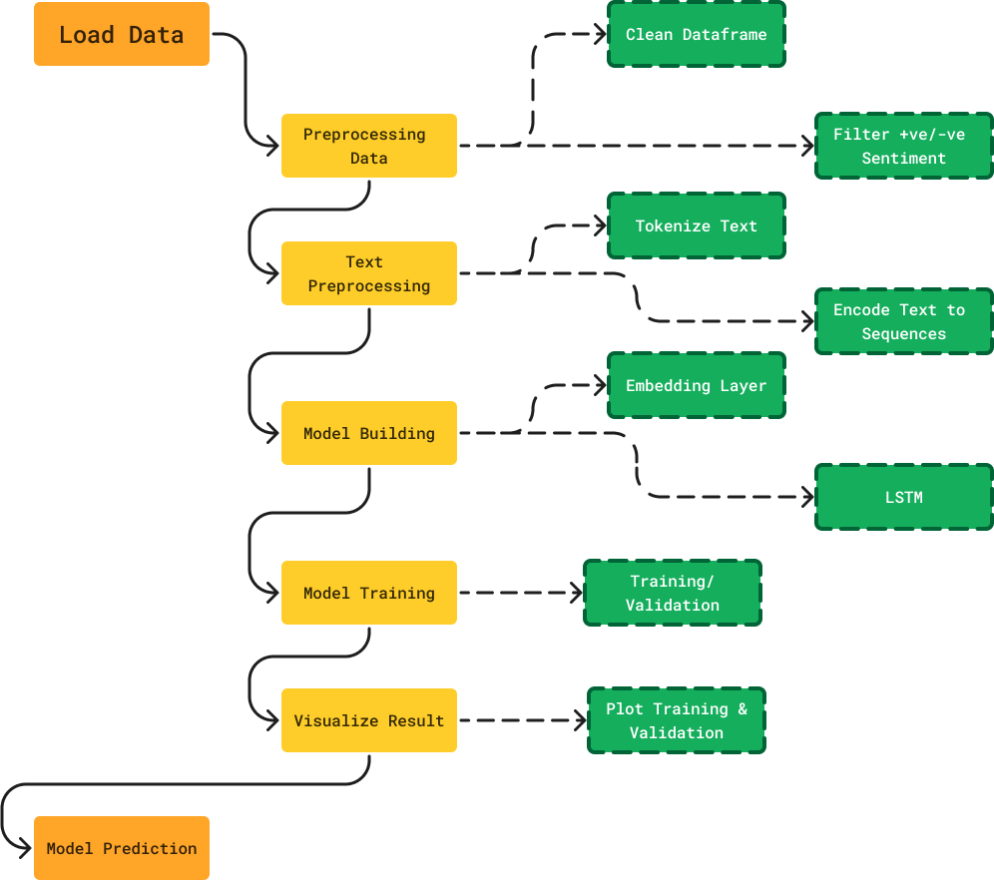
MODELLING
3/21/2024 Annual Review
‹#›

Slide 10
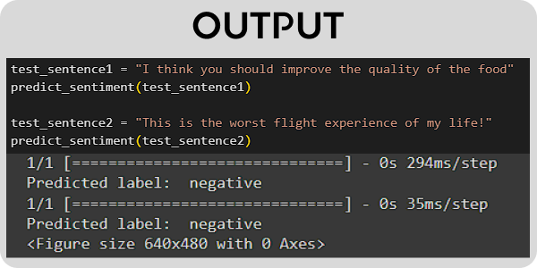
RESULTS
3/21/2024 Annual Review
‹#›

